Slide 1

Team : Code To Help
ENSURE NO GIRL IS LEFT BEHIND!
43

Slide 2

Problem Statement & Solution
JOINING THE DOTS FOUNDATION is seeking a comprehensive digital solution to:
Reduce the hassle of manually selecting students for bootcamps.
Prevent student dropouts through proactive measures.
Implement an automated attendance system.
Streamline various administrative tasks.
SOLUTION:
Shift most operations to a streamlined online platform to enhance efficiency and impact.

Slide 3

Key Focus Areas
Selection Process
Dashboards
Dealing With Dropouts
Help With Placements

Slide 4


System Architecture
All Learning Modules
USER
Attendance Overview
Scores / Grades
Leaderboard
LOGIN
Employers Database
Students Database
ADMIN
Automated Emails
Test Scores / Leaderboard

Slide 5
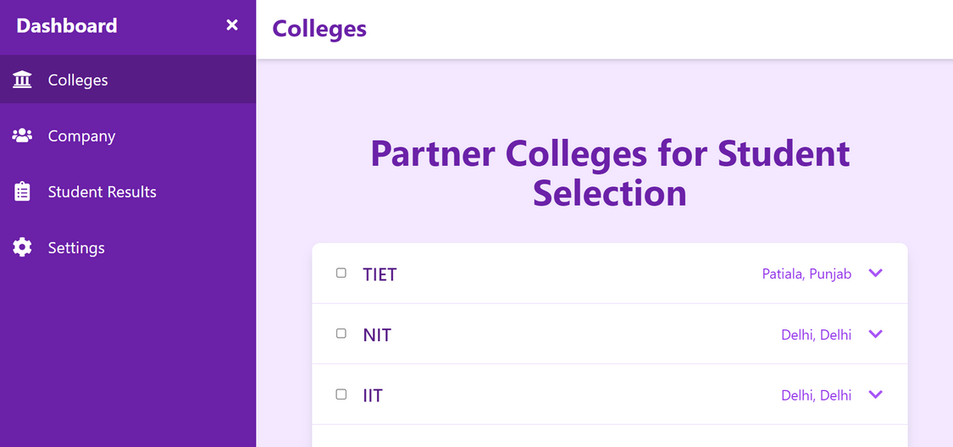
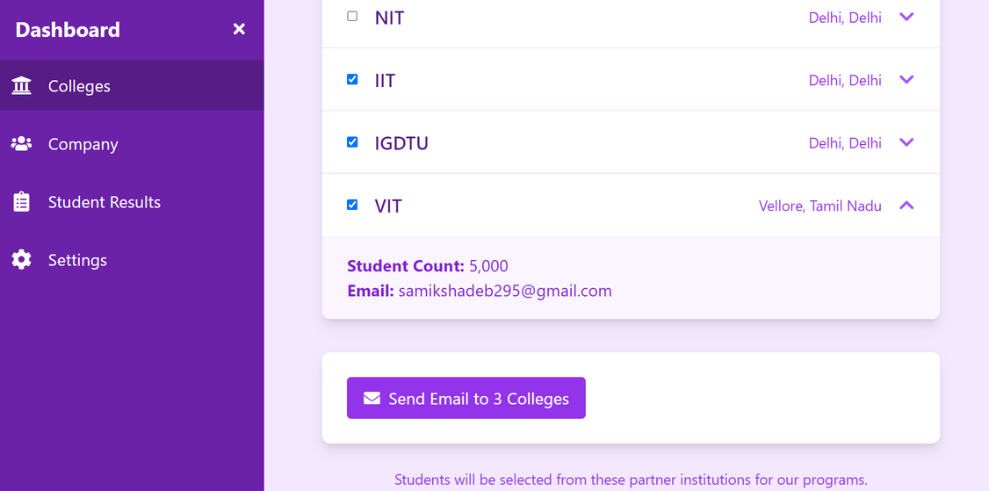
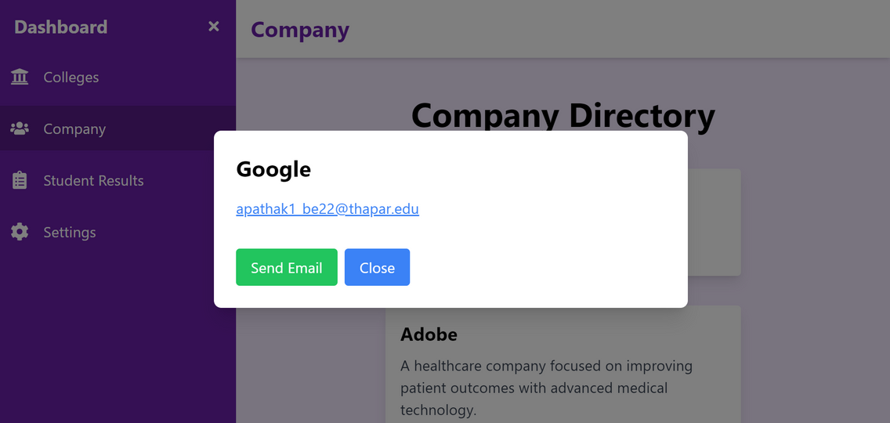
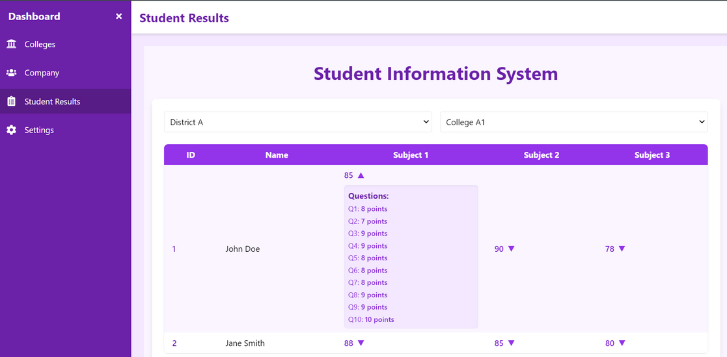
Project Snapshots
Admin & User’s Dashboard

Slide 6
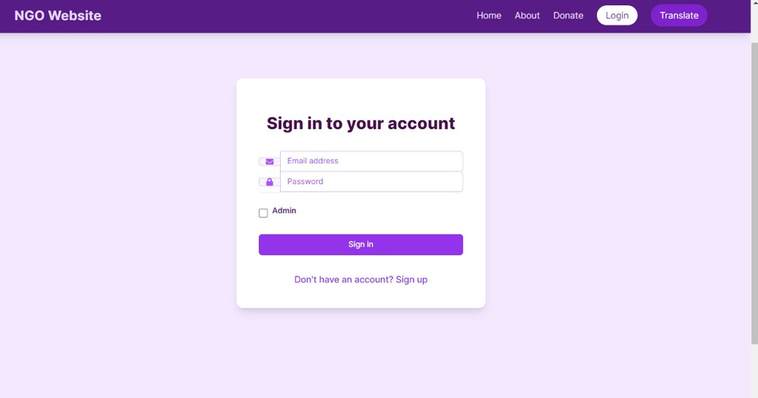

Project Snapshots

Slide 7


Future Scope
Test analysis using AI/ML
Interactions with successful persona
Proactive mentor engagement for low attendance
Interactions with parents
Leaderboard
Attendance Tracker

Slide 8
Thank you!
TIME FOR LIVE DEMO! ...

